Slide 1




SHRI GURU GOBIND SINGH JI GOVT. COLLEGE,
PAONTA SAHIB, SIRMOUR (H.P)

Slide 2

B.A. 2nd YEAR
COURSE NAME: SPORTS TRAINING
COURSE CODE: PED204TH

Slide 3

TRAINING LOAD

Slide 4
TOPICS TO BE COVERED
MEANING OF TRAINING LOAD
TYPES OF LOAD
PRINCIPLES OF TRAINING LOAD
PRINCIPLES OF LOAD INTENSITY
PRINCIPLES OF LOAD VOLUME

Slide 5
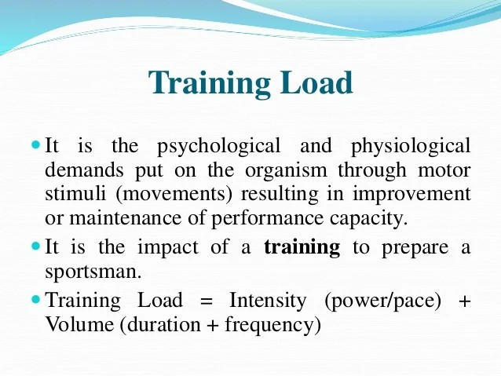
MEANING OF TRAINING LOAD

Slide 6
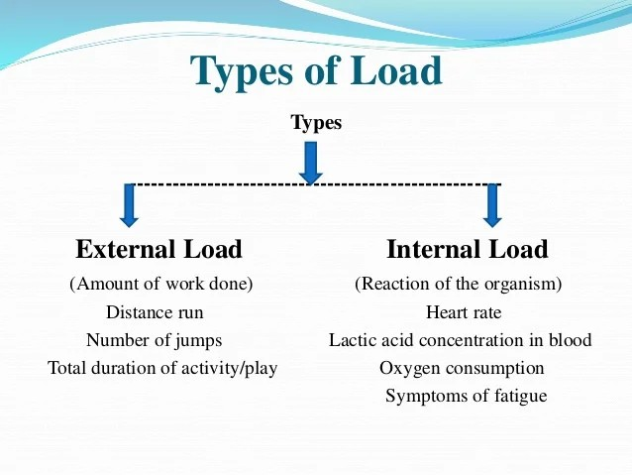

Slide 7
External Load Internal Load (Amount of work done) (Reaction of the organism) Distance run Heart rate Number of jumps Lactic acid concentration in blood Total duration of activity/play Oxygen consumption Symptoms of fatigue.
External Load  It is the work done by the sportsman. Eg. The distances run by a distance runner.
Internal Load It is the psycho-physiological reaction of sportsman to external load. The degree of internal load is judged by pulse rate, lactic acid concentration in blood and various biochemical changes in the tissues. It can also be judged by various symptoms of fatigue. Eg. Sweating, changes in colour, Increase in heart rate etc..
External and internal load are inter-related. For biological adaptations internal load is a must and should be optimum. Since the individuals are differ according to their need the external load must be applied to get optimum internal load.

Slide 8
PRINCIPLES OF TRAINING LOAD
1. Principles of Continuity and Repetition of Load
2. Principles of Optimum Load
3. Principles of Load and Recovery
4. Principles of Specificity of Load
5. Principles of Progression of Load

Slide 9
1.Principles of Continuity and Repetition of Load
The load must be given several times to achieve the stable increase in performance capacity and the training should be continuous, otherwise achieved adaptations or performance improvement will be lost after some time.

Slide 10
2.Principles of Optimum Load
The load given is neither too low nor too much excessive, because no super compensation takes place or recovery process is slowed down respectively. Therefore, for super compensation and optimum recovery the optimum load must be given.
3.Principles of Load and Recovery Optimum
load is essential to achieve good super compensation and the super compensation will take place only if enough time for recovery is given.

Slide 11
4.Principles of Specificity of Load
Since specific type of load leads to a super compensation of a particular type of substance, when different performance factors need to be improved different type of load should be given.
5.Principles of Progression of Load
The load should be increased from time to time for continuous improvement of performance. According to the need, the lad should be given. For example, higher load should be given for the adaptation to a higher level.

Slide 12
PRINCIPLES OF LOAD INTENSITY
The principles of load intensity is sub divided into,
Intensity of Stimulus:
It refers to the pace of doing work or pace of doing one single movement. Eg. Speed of 100 mts sprint in mts/sec.
Density of Stimulus:
It is the ratio between the load and recovery of two motor movements. Eg. Rest period between the two 100 mts sprint.

Slide 13
PRINCIPLES OF LOAD VOLUME
The principles of load Volume is sub divided into,
Duration of Stimulus:
It is the time period for which a single motor stimulus acts on the organism. Eg. Total time taken to cover the distance in 100 mts Sprint.
Frequency of Stimulus:
It is the number of time/repetition a motor stimulus (one set of exercises) is given. Eg. Rest period between the two 100 mts sprint.

Slide 14


